Slide 1
Multi-Task Learning
A comprehensive study
Presented by: Nevil Shah(015964975)

Slide 2
What is a task?
A machine learning task is the type of prediction or inference being made, based on the problem or question that is being asked, and the available data.
For example, the classification task assigns data to categories, and the clustering task groups data according to similarity.

Slide 3
Introduction to Multi-Task learning
In the majority of machine learning scenarios, we focus on completing one task at a time.
But, this method will ultimately reach its efficiency limit, frequently because of the size of the data collection or the model’s capacity to extract useful interpretations from it.
To accomplish our intended job, we often train a single model or an ensemble of models.
After that, we adjust and modify such models till their effectiveness plateaus

Slide 4
Introduction to Multi-task learning
While doing things this way often results in satisfactory performance, we miss out on information that could have improved our performance on the measure we care about because we are so intently focused on our one task.
We can help our model generalize more effectively on our initial job by sharing features across similar tasks.
This method is known as Multi-Task Learning.

Slide 5
Usage
The use of multi-task learning has become commonplace in a variety of fields, including :
recommendation systems,
computer vision,
natural language processing
When there is some degree of correlation between the activities, multi-task learning should be applied.
For example, , it is likely that two tasks that require classifying animal images will be connected since both involve learning to recognize fur patterns and colors.

Slide 6
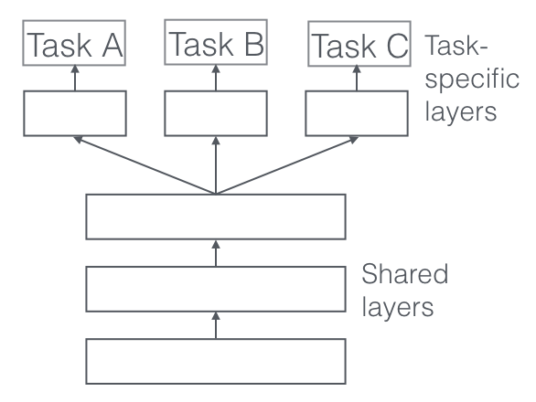
The above figure is a common representation of a model implementing Multi-Task learning.
In this situation, the model is compelled to learn a middle representation that provides adequate details for all of the jobs.

Slide 7
Hard Parameter Sharing
Hard parameter sharing enables processes to exchange certain set of model parameters, lowering storage costs and enhancing prediction accuracy.
A deep neural network’s bottom layers are typically shared between tasks while using different top layers for each one.
This method lowers the danger of overfitting.

Slide 8
Soft Parameter Sharing
Each task in the method of soft parameter sharing includes its own group of parameters.
The discrepancies between the shared layers are then minimized by regularizing these task-specific layers during training.
As a result, layers are favored to have comparable weights while still enabling task specialization in particular areas.

Slide 9
Auxiliary tasks
Auxiliary tasks are tasks we try to accomplish with the sole objective of better performing one or several primary tasks.
The primary task and the auxiliary task should generally be related, and the auxiliary activity should encourage the network to pick up crucial details for the primary task.
For instance, if the main objective is to categorize data sequences, we can define a secondary task that is to use an autoencoder to reconstruct the sequence.

Slide 10
Internal Mechanism
Implicit data augmentation: A model that learns two tasks simultaneously is able to learn a more broad representation since various tasks have different noise patterns. When tasks A and B are learned together, the model may average the noise patterns to produce a better representation of F than when tasks A and B are learned separately, which runs the risk of overfitting to task A.
Attention focusing: Due to the fact that additional workloads will provide more information for the usefulness or non-usefulness of those qualities, MTL aids the model in concentrating on the variables that actually matter.

Slide 11
Internal Mechanism
Eavesdropping: While some qualities G are challenging to learn for some work A, they are simple to master for some task B. This may be due to the more intricate interactions between A and the features or because other features are making it more difficult for the model to learn G. We can allow the model to eavesdrop using MTL so that it can pick up on job B and learn G.

Slide 12
Conclusion
We illustrated multi-task learning in this overview along with more of its most recent work on MTL for Deep Learning. Even if MTL is being used more frequently, the hard parameter sharing method is still widely employed for MTL that is based on neural networks.
However, our knowledge of tasks, including their similarity, relationships, hierarchies, and benefits for multi-task learning, is still limited, and we need to examine them in greater detail if we are to fully appreciate MTL’s capacity for generalization with regard to deep neural networks.

Slide 13
Thank you

